Slide 1
Rehoboth – Dewey Chamber September 14, 2022

Slide 2
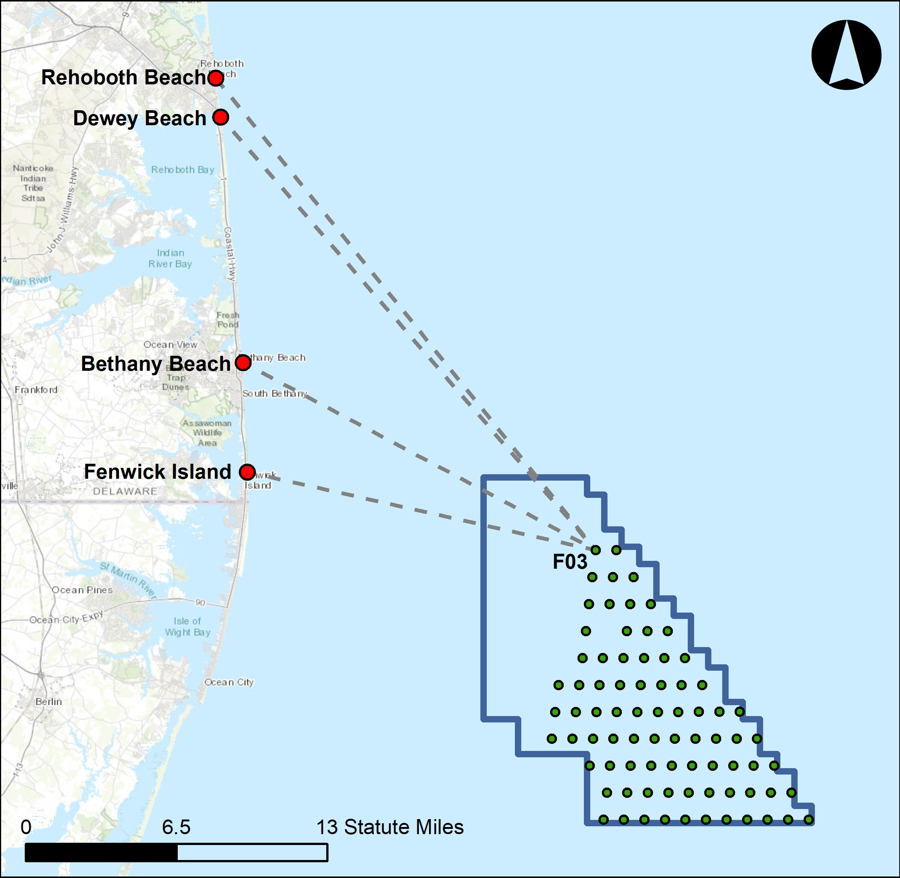
US Wind Projects
80,000-acre lease area, 12–27 statute miles from OC, MD
Combined projects will deliver ~1,100 MW of clean energy to the grid. Will power ~340,000 area homes.
Deliver with 76 turbines, 3 offshore substations (OSSs). Scour protection will cover less than 1% of lease area
Closest turbine 24 miles from Dewey, 26.2 miles from Rehoboth
24-26 Miles
17 Miles
15 Miles
US Wind (MARWIN, Momentum)

Slide 3
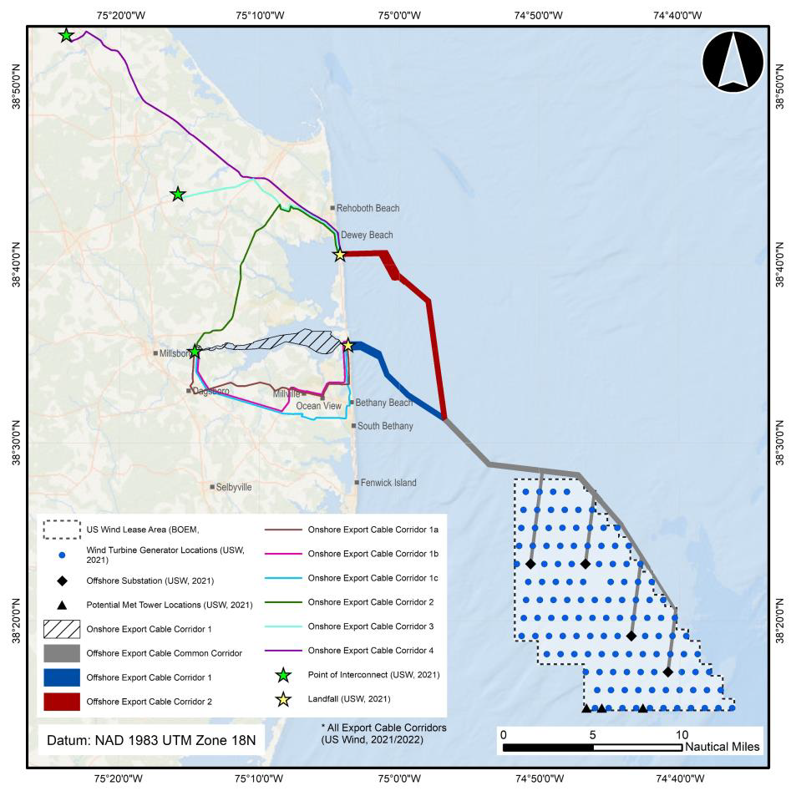
Landfall / Connection to the Grid
Two potential landfall locations
Tower Road Beach
3R’s Beach
7 onshore export cable routes to 3 interconnection points to the grid
Cables buried; no above ground infrastructure
Horizontal Directional Drilling used to avoid disturbing beaches, dunes, and wetlands
Preferred path is least disruptive

Slide 4
Next Steps
COP is now public (BOEM.gov)
Construction & Operations Plan (COP)
Environmental & Technical Review
Constructions, Operations & Maintenance
Approve
BOEM deemed COP “sufficient and complete” on June 8th, 2022
Two-year public process
Plans must meet or exceed all NEPA standards
Begin 2024
First 300 MW in 2025
Next 800 MW in 2026

Slide 5
How Offshore Wind Benefits Delaware
Local
Investment
Energy & Jobs
Address Coastal
Flooding

Slide 6
Important Considerations
US Wind has been studying the lease area since 2014
Able to develop and operate safely with negligible to no negative impacts on local ecosystems
Significant ecosystem benefits over long term
Offshore wind energy is very efficient – full lifecycle energy and carbon payback in ~ 7.5 months or less
Offshore wind energy is affordable – US Wind’s momentum project to cost average MD ratepayer $0.76 / month

Slide 7
Mike Dunmyer Delaware Development Manager
m.dunmyer@uswindinc.com

